Slide 1
RALPH
This Game BLOWS…….CHUNCKS

Slide 2
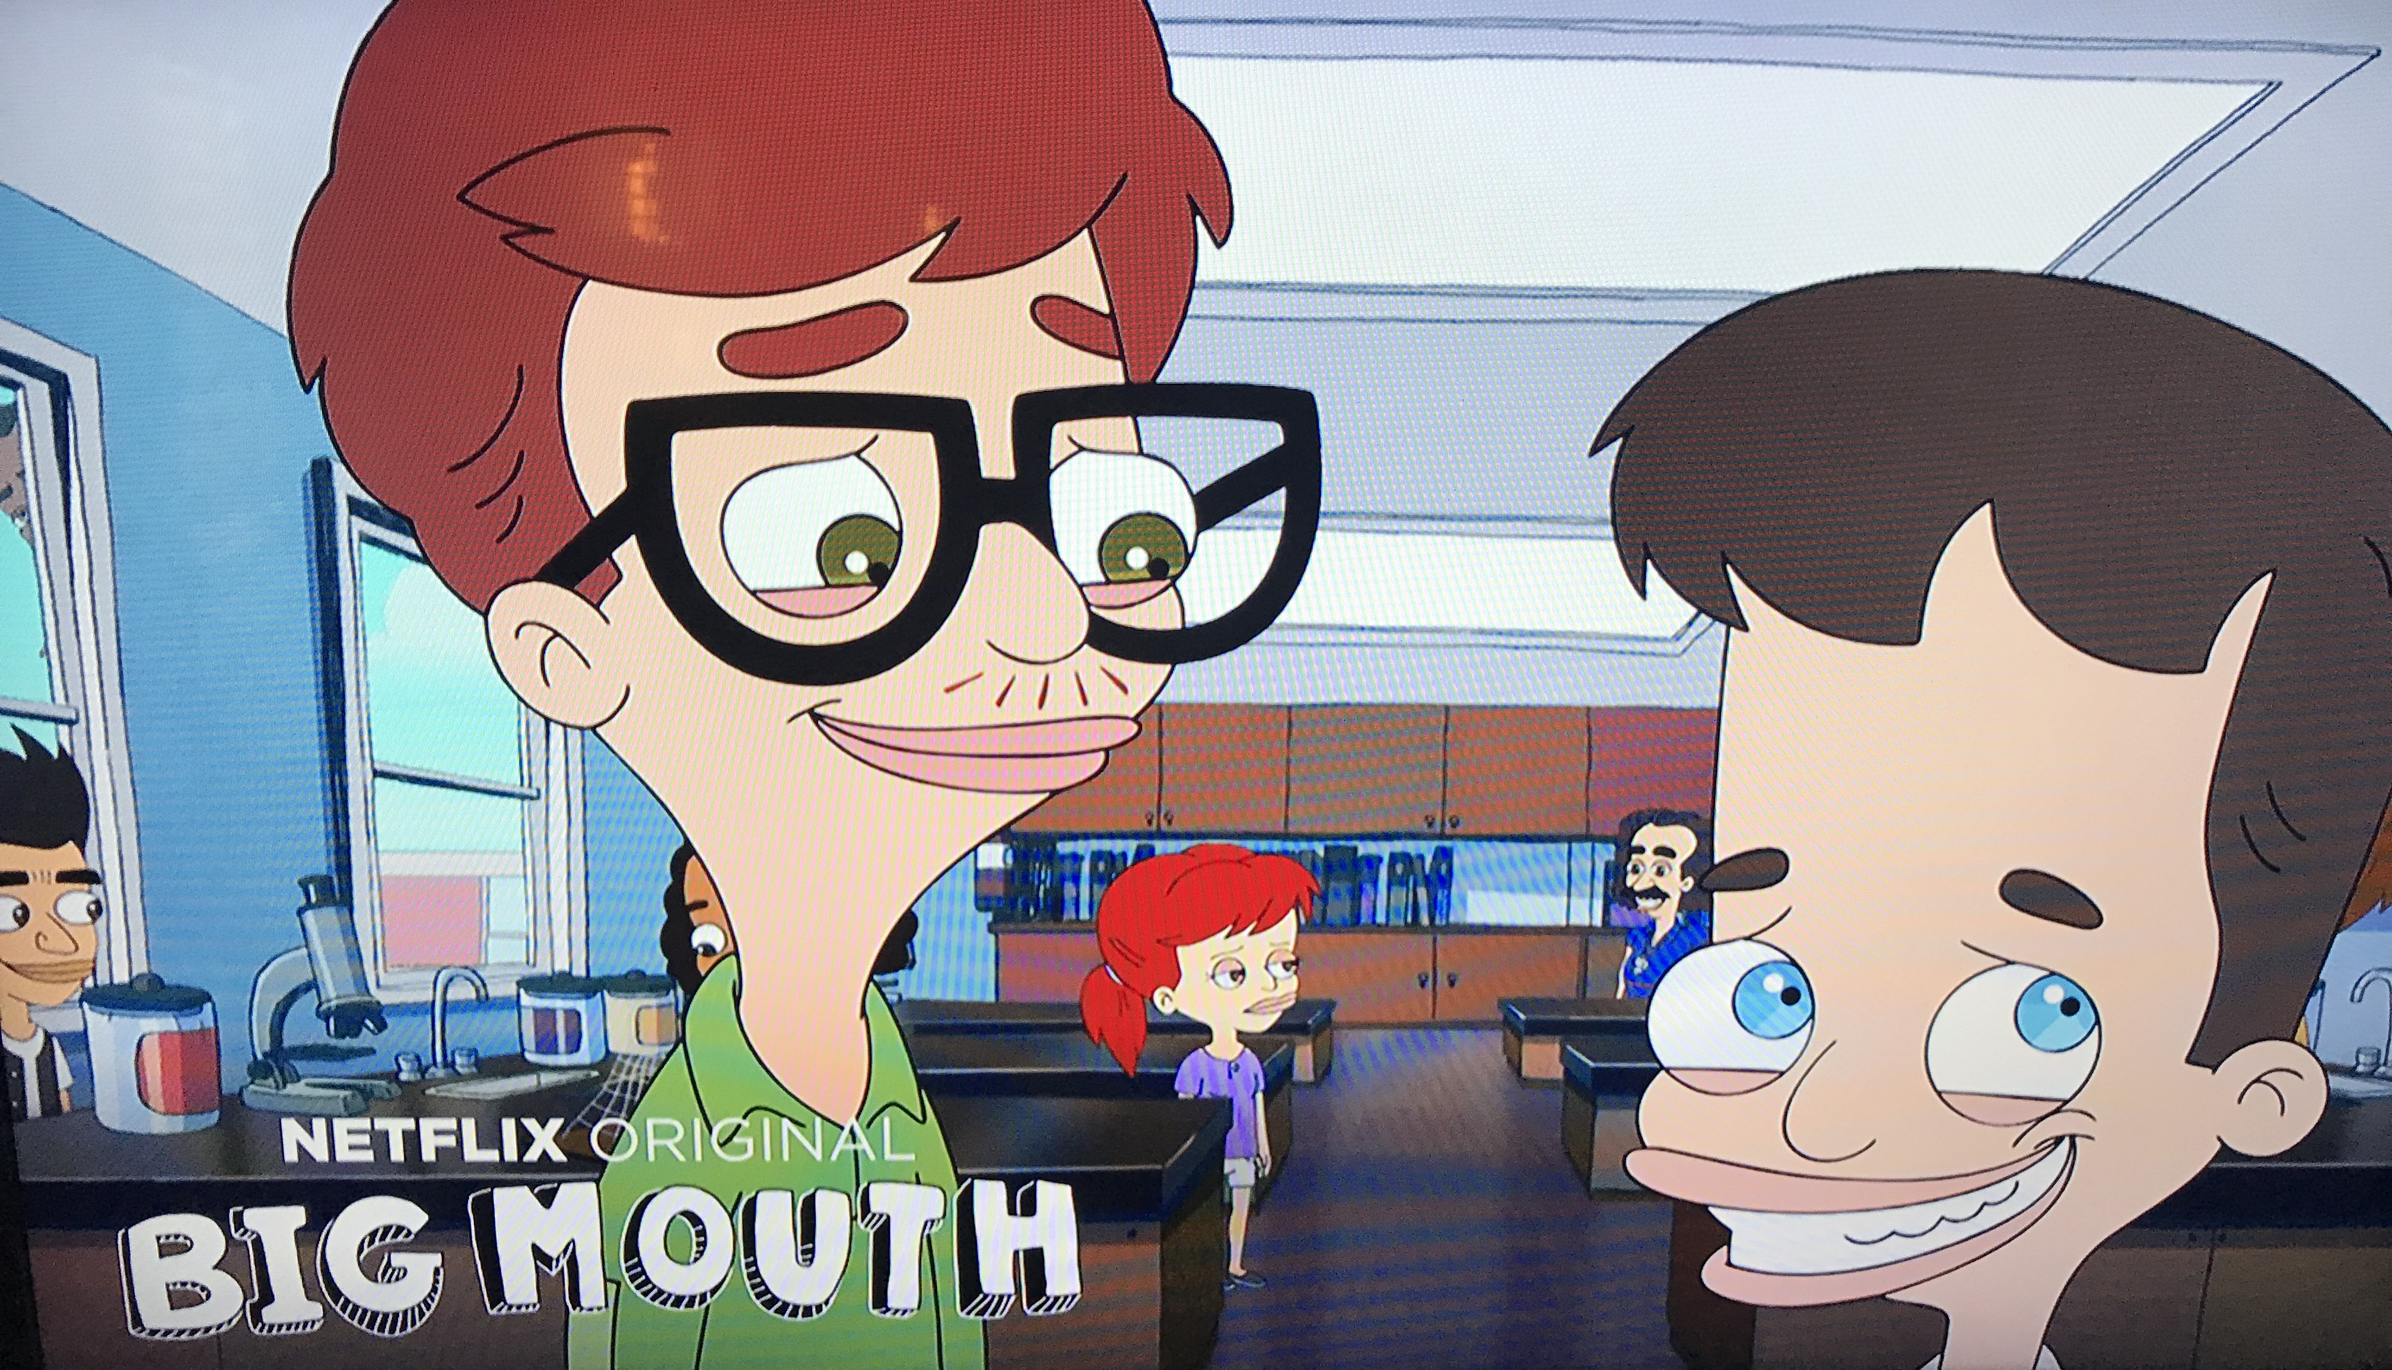
RALPH
This Game BLOWS…….CHUNCKS

Slide 3
Game Mechanics
Ralph loves to eat. Ralph can’t hold anything down. Player purchases groceries at the store using coins and then feeds Ralph to earn coins. When Ralph ralphs, barf spews all over the screen. Player uses cleaning supplies to clean the screen. Cleaning supplies may be purchased at the store using coins. The bigger the spew, the more coins are earned. Player also receives free coins, each day as a gift. On occasion, player also receives food items or cleaning supplies as a gift. Player can earn coins by getting Ralph to ralph, receiving daily gifts, watching ads, or purchasing coins.

Slide 4
Coins Diminishing Returns
Coins earned for each barf are equal to 75% of coins used to feed Ralph and cause the barf.
Clean-up must also be replenished and uses a fixed amount of coins per clean-up.
A player should be able to play for approximately 10 minutes before coins are depleted.
When coins are depleted, Ralph becomes hungry and begs for food.

Slide 5
Daily Gifts
Each day you get a gift of coins that is equal to 3 – 7 awkward rounds of ralphing.
The daily gift also includes a bonus if you watch an ad.
10% of the time coins for 1 more round
84% of the time a food item
1% of the time a ralph character
5% of the time cleaning supplies

Slide 6
Ads
An interruption ad plays at the end of every cleaning randomly as follows:
10% chance after 1 round
30% chance after 2 rounds
50% chance after 3 or more rounds
A token food item is given after every interruption ad.
A player can watch an ad at any time for coins equivalent to 110% of food that is needed to make ralph barf.

Slide 7
Store
Coins can be used to purchase food, cleaning supplies, mystery gifts, and Ralph characters.
Amount of coins used for food correspond to how much spew is produced.
Cost of cleaning supplies corresponds to both number of uses and effectiveness.
Wipes clean a smaller area than Barf Buster™ and Robosuck™
Cost of characters corresponds to how strong their stomachs are in resisting barfing.
At checkout, offer coupons
75% of the time offer 25% off
25% of the time offer 10% off

Slide 8
Awkward Situations (worlds)
Ralph is seated in an awkward situation with other people.
Text bubbles show the conversation
Ralph gets sicker and sicker until he ruins the moment by ralphing all over the place.

Slide 9
Awkward Situations:
Date/ Restaurant
Wedding
Church
Meeting
Airplane
Car
Picnic/BBQ
Party
Movie/Play
Class/School
Soccer Game
Concert
Fair
Amusement park
Speech
Beach
Foods:
Brussel Sprouts
Hard boiled egg
Anchovies
Worms
Tortia chips
Liver
Snails
Buttermilk
Chicken hearts
Chocolate covered flys
Gifts:
Daily Food Gift
Surprise Gifts
Coupons good for x% off at the store
Ralphs Characters
Regular Ralph
Female Ralphina?
Punk Rock Ralph
Trump Ralph
Clinton Ralphina
Kapernick Ralph
Jedi Ralph
Cleaners:
Barf Wipes
Barf Buster
Robo Suck
Barf Mop

Slide 10


MainScreen
500
5
10
1h 59min
Play
Shop
Career
Stats
News
Settings

Slide 11
Opening a coin bag or gift box
X
2000
25% more

Slide 12
Game Play 750x1334 pixels
500,000
I just love this place
He’s go’na blow

Slide 13
Store
X
1 week supply
200 OR $.99
Cleaning Supplies
50 OR $.99
Awkward Situation
5000 OR $1.99
Pile of coins
$7.99
Character Pack 1
$11.99
Mystery Box
$4.99
RARE
1h 59min

Slide 14
Career
Stats
X
Lifetime ralphs 543
Lifetime coins 2,334,225
Food eaten 90,2314
Food Items Unlocked 25/327
Cleaning Items Unlocked 2/3

Slide 15
News
X
New food item available:
Cooked tree bark. YUM (say’s no one)
New awkward situation now available:
Could this be the most embarrassing place to ralph ever? Why does Ralph eat anything you place before him?

Slide 16
Settings
X
Music Off
Credits
Sounds Off
DangFunGames.com
Privacy Policy
Disgustinger Mode
Facebook
Contact Support

Slide 17
Main Menu
Database
Game Controller
Game Play
Splash Screen
Player Settings
Sound
Music
Language
Player Inventory
Coins
Food
Cleaners
Characters
Levels
Player Unlocked
Coins
Food
Cleaners
Characters
Levels
Main Menu

Slide 18

5

Slide 19
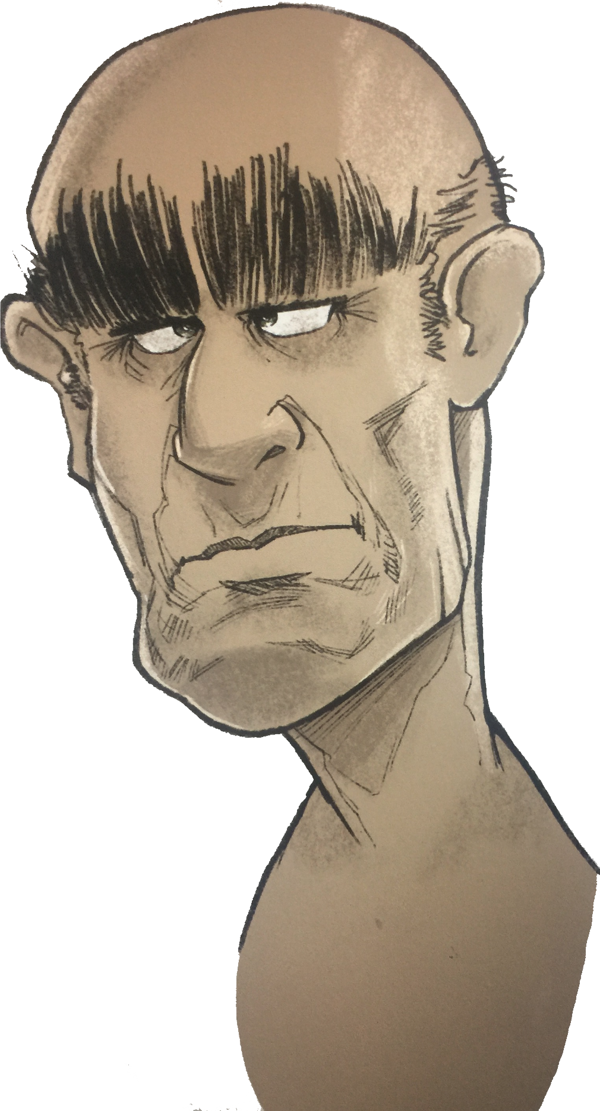
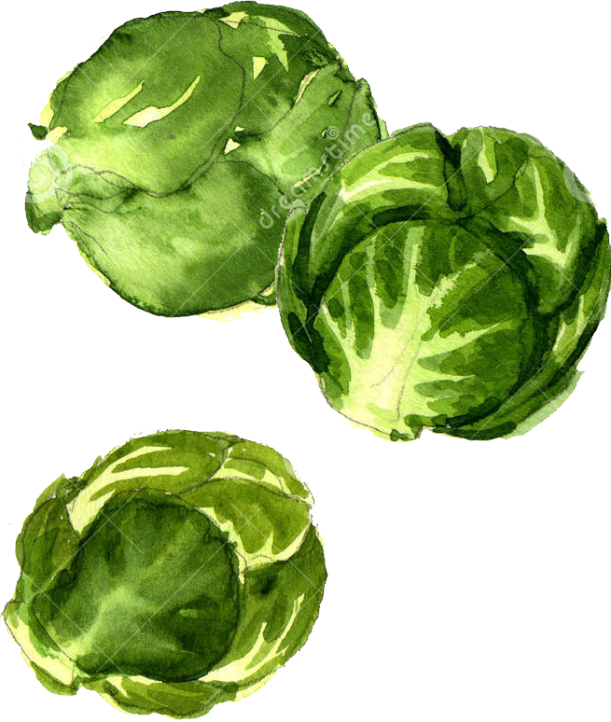
Main Menu
500
Main Menu
500
Main Menu
500
Shop
Shop
Shop

Slide 20

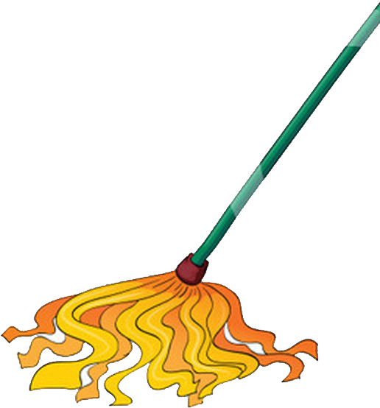
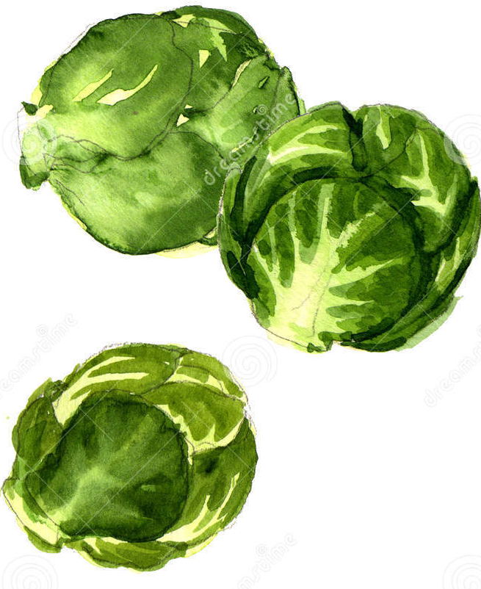
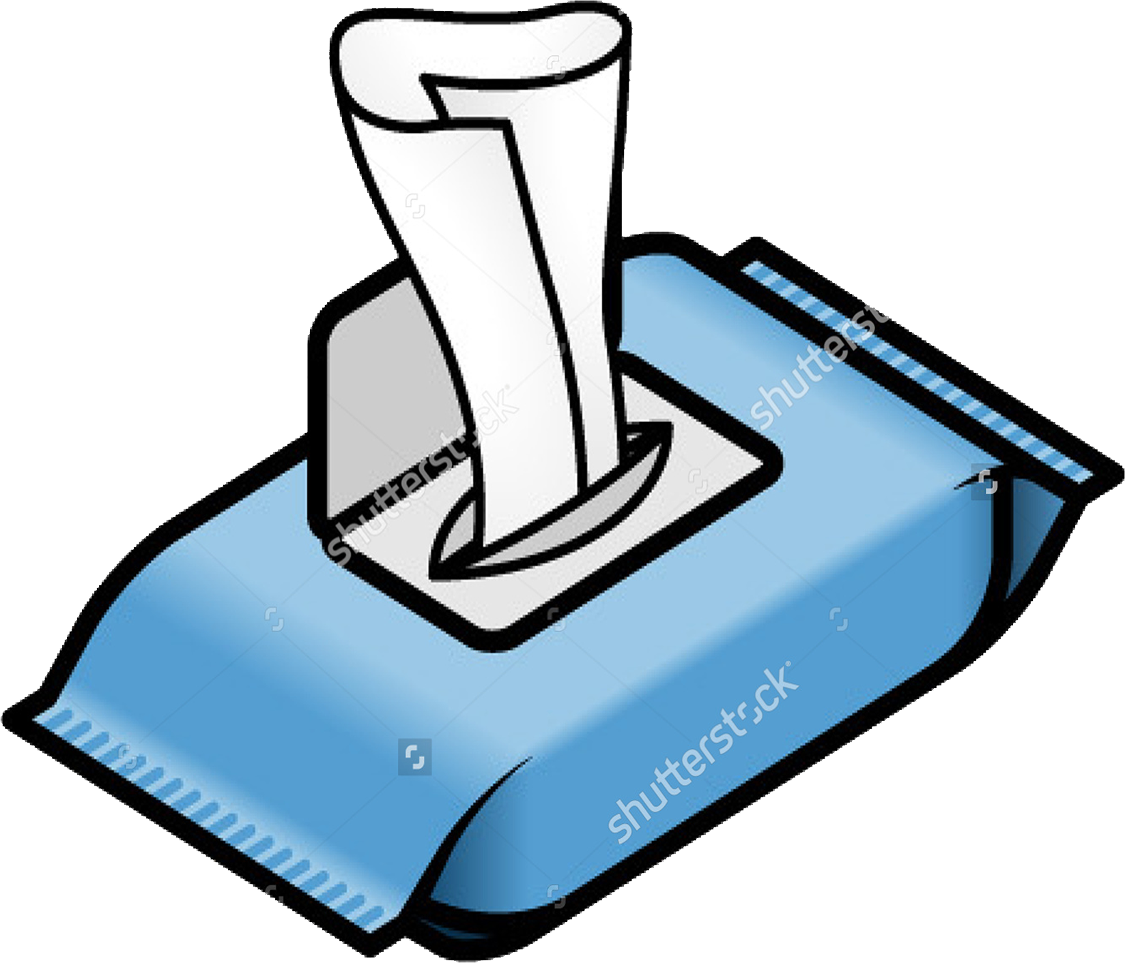

Main Menu
500
Main Menu
500
Main Menu
500
Shop
Shop
Shop

Slide 21


Main Menu
560
Main Menu
800
Main Menu
900
Shop
Shop
Shop

Slide 22
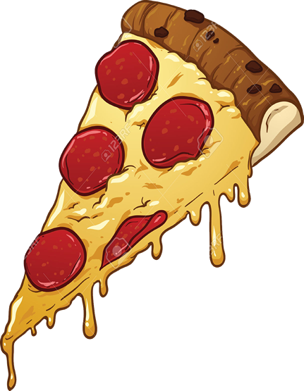

Main Menu
900
Main Menu
900
Main Menu
900
Shop
Shop
Shop

